Slide 1
Crashed in a Minute on Table
Dr A M Thirugnanam, Senior Interventional Cardiologist
Director of Interventional Cardiology
www.bestmedicalschoolonline.com
www.cardiologycourse.com
Hyderabad, India

Slide 2
56 years old Lady Doctor
Had known history of hypertension for 10 yrs. Recovered from severe with multiple organ failure before 6 years back.
Osteo-arthritis on self medications ( NSAID)
Sedentary, BMI-26.
Food-Non Veg, Positive Dyslipidemia.
Never undergone any cardiac evaluation before.
Default medications for HTN, DLP

Slide 3
Clinical Evaluation
One day at 7 PM arrived in emergency department with crescendo angina for 36 hrs. took first EKG after 24 hrs at an outside diagnostic center and got reported with AMI. Attended emergency at 36hrs.
EKG- ST elevation in all chest leads and ST-T changes in other leads.
Elevated cardiac enzymes, RBS-104 mg, Cr-1.4, CTnI-2600ng/dl, LVEF-35% with severe hypokinetic IVS and Apical LV, CXR-N and USG Abdomen- mild Hepatomegaly and mild renal parenchymal changes.
BP-120/80, HR-90/min, O2-92%, Skin- wet, Lungs- mild bilateral crepitations.

Slide 4
Emergency Treatment
Loading dose clopidogrel, ASA and Bolus reopro given. Half dose of TPA inhibitor given at night. But Patient was experiencing intermittent chest pain whole night.
Next took the patient for CAG with Noradrenalin.
CAG-LAD proximal to mid 90-96% type C lesion, RCA- 80-90% lesion at mid level.
We kept additional artery and venous lines for supporting devices.

Slide 5
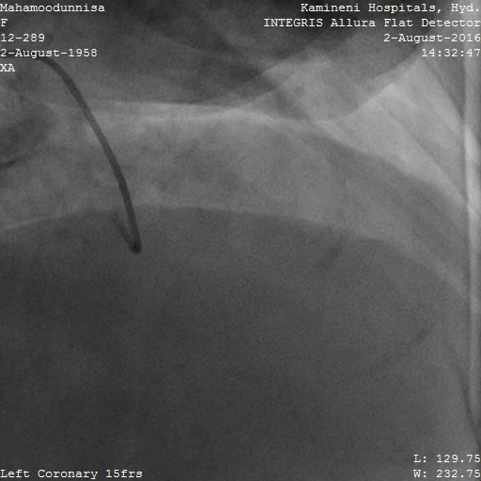
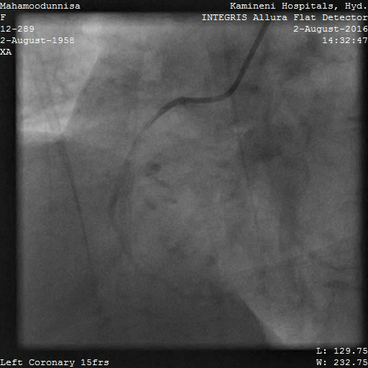
CAG through Right Radial Route

Slide 6
After CAG in 10 min developed Hypotension
Patient was on Noradrenalin and Dobutamin. Suddenly developed hypotension while discussing with relatives. Increased the dose to maximum when hypotension.
Put stent 2.75/23 at 12 atm to LAD proximal

Slide 7
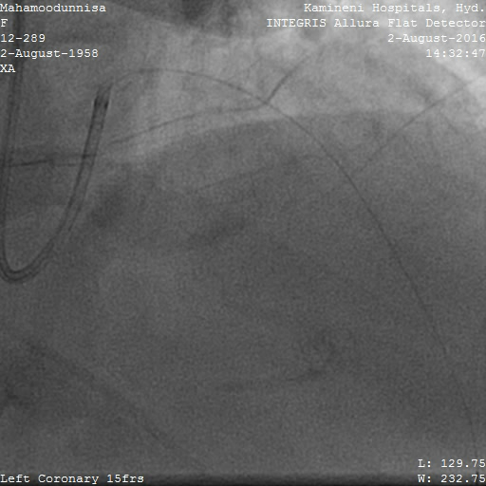
There is no damping in LAD. 6 Fr Guide

Slide 8
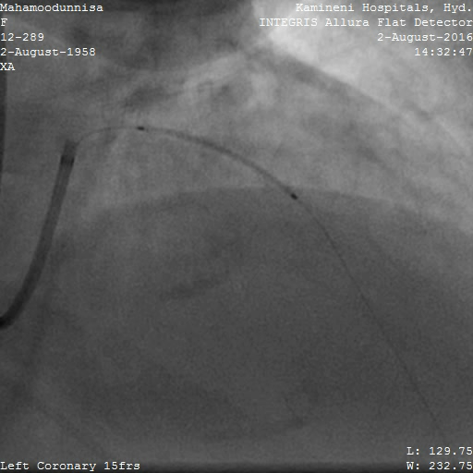
Stent deployment. Xience-Exp 2.75/28mm

Slide 9
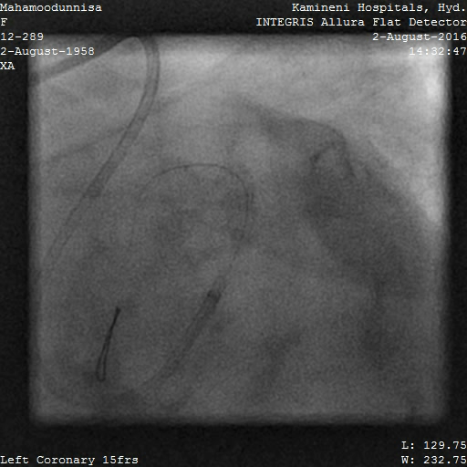
No Dissection and Damping

Slide 10
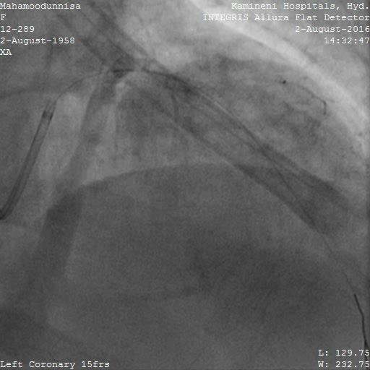
A minute of Complete cardiac arrest

Slide 11
There is no time for Device management
All essential measure have been taken. But nothing were achieved.
The reasons were lot to think and discuss

Slide 12
Larger amount of myocardium insult
Larger volume of myocardial apoptosis is the main reason for slow flow, no flow and sudden cardiac arrest in side the hospital and out side the hospital.
In Massive apoptosis no procedure, measures, devices and management will work.
So far we have no any commercially available bio marker to assess massive apoptosis is called heavenly closure of Myocytes function.

Slide 13
Timing of Apoptosis in AMI and Markers
6-120 hrs. after MI- TUNEL + DNA laddering
3-14 hrs. after MI – TUNEL + DNA laddering
3.5-22 hrs. after MI – Annexin-V
Some other markers like; Bcl-2, Bax, sFas, P53.
JAK/STAT- Janus Kinase/ Singnal Transducer and Activator of Transcription
SAPK- Stress Activated Protein Kinase.
sFas- an inhibitor of apoptosis, sFas ligand –an inducer of apoptosis.
TUNEL- Terminal deoxynucleotidyl Transferase mediated dUTP nick end Labelling

Slide 14
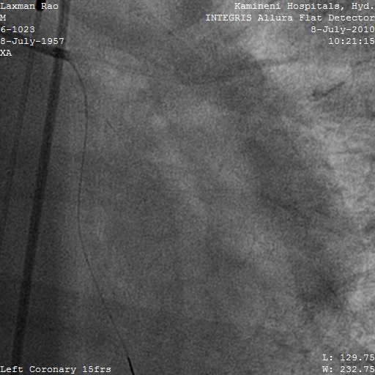
Identifying Radiolucency by Fluoroscope
Ex. AWMI. WP-3 days
Evolving ILMI. WP-4 days. IABP support

Slide 15
What I have found from my Researches
Those who recovered from multiple organ failure will have poor result in ACS.
Window period more than 36 hrs. Crescendo angina and highly elevated CtnI.
Sedentary life style
Female always comes under high risk
Finally important and only one pathological cause is Apoptosis of large volume of myocytes. Massive apoptosis happen in above said risk factors.

