Slide 1
Hypertension Learning Academy
Dr AM Thirugnanam, Senior Interventional Cardiologist,
Ipcard Cardiac Care Center, Hyderabad, India. 28-04-2018

Slide 2
How many of you have confident of treating HTN completely?

Slide 3
How many of you worry about number of drugs in a patient for HTN?

Slide 4
One patient’s History
HTN for 40 years, never below 170mmhg and 100mmhg
DM for 3 years
Old CVA, recurrent CVA events old Fresh infarct in both hemisphere of brain
Bilateral renal artery stenosis and Post renal artery stenting
Severe Triple vessel diseases, post LAD stenting
Severe RT vertebral and bilateral common carotids diseases
CKD- stage-4, eGFR- 25ml

Slide 5
Following medications (15 drugs)
Prazosin 10 mg BD
Nitroglycerine 6.4mg BD
Torsemide 10mg TID
Cilnidipine and Metoprolol BID
Nicorandil 10 mg BID
Trimetazidine 35mg BID
Rosuvastatin-20mg OD
Clopidogrel and Aspirin-150/75 OD
Acinocoumarol 1mg OD
Calcium and Vit-D3
Strocit-P BID
Vertin 16 mg BID
Esomeprazole and Domperidone OD
Clonazepam 1mg OD
Cereplus OD

Slide 6
BP MEASUREMENT: if we fault at technique
 | ❒ BP (mm Hg) if not done
Rest ≥ 5 min, quiet | ↑ 12/6
Seated, back supported | ↑ 6/8
Cuff at midsternal level | ↑ ↓ 2/inch
Large enough cuff | ↑ 6-18/4-13
Bladder center over artery | ↑ 3-5/2-3
Deflate 2 mm Hg/sec | ↓ SBP/↑ DBP
No talking during measurement | ↑ 17/13
If initial BP > goal BP: | 1st reading higher
3 readings, 1 min apart | • “Alerting response”
Discard 1st, average last 2
CAN WE TEACH/IMPLEMENT? DOUBTFUL!
Hypertension 2005; 45:142 J Hypertens 2005; 23:697 Can J Card 2012; 28:270

Slide 7
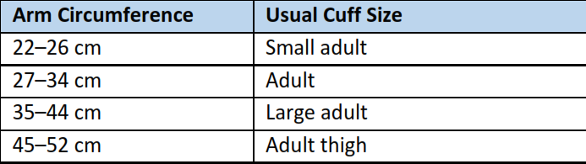
Selection Criteria for BP Cuff Size
Hypertension. 2017 Nov 13. pii: HYP.0000000000000066.

Slide 8
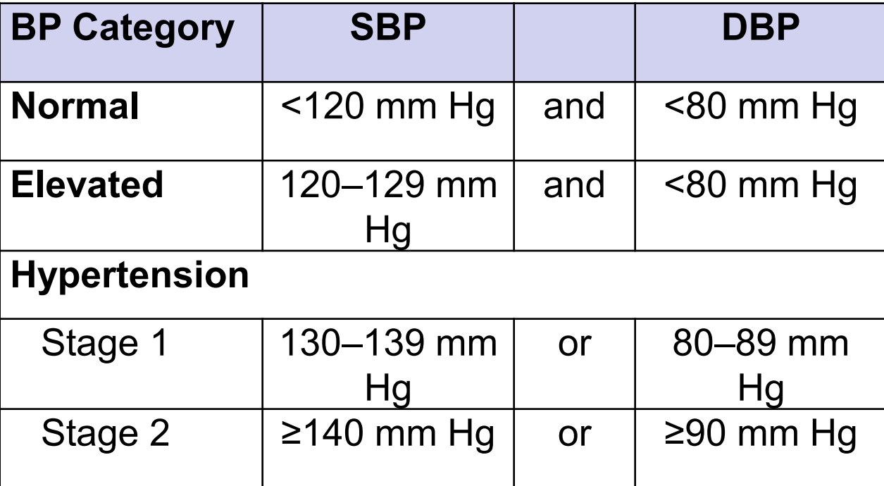
Definition of High BP
Hypertension. 2017 Nov 13. pii: HYP.0000000000000066.

Slide 9
AOBP (Automated Office Blood Pressure)
It takes multiple readings taken with a fully automated recorder with the patient resting alone in a quiet room.
When these principles are followed, office-induced hypertension is eliminated
AOBP exhibits a much stronger correlation with the awake ABPM
AOBP also simplifies the definition of hypertension in that the cut point for a normal AOBP (< 135/85 mm Hg) is the same as for the awake ambulatory BP and home BP
CJC. 2012. Volume 28, Issue 3, Pages 341–346

Slide 10
Office BP measurement (OBP)
Traditionally office blood pressure measurement has been performed using a sphygmomanometer and stethoscope.
Auscultatory technique is increasingly being replaced by automated techniques.
  mercury as a toxic metal is being phased out
  properly validated oscillometric devices are readily available
An alternative to the mercury sphygmomanometer is “hybrid” sphygmomanometer, which combines features of electronic and mercury devices.

Slide 11
Indications of ABPM
1. 24 hour Average BP
2. Daytime and nighttime BP pattern
3. Nocturnal dipping status and excessive dipping if any
4. Early morning surge
5. BP load i.e. percentage of reading higher than normal
6. BP variability derived from 95% confidence units
Clinical j of Hypertension .2017;1(3)691-694

Slide 12
Uses of ABPM
To confirm diagnosis of Hypertension
Initiate antihypertensive treatment
Poorly controlled blood pressure (resistant or labile hypertension)
Frequent hypotensive symptoms
White coat hypertension (i.e. high BP in doctor`s clinic, normal at home )
Masked hypertension (i.e. normal BP in doctor`s clinic, high at home)
Clinical j of Hypertension .2017;1(3)691-694

Slide 13
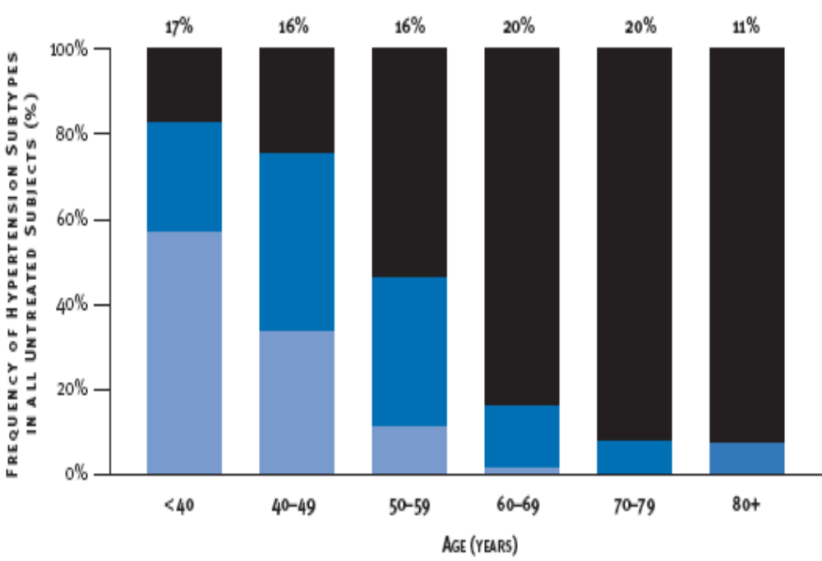
Frequency Distribution of Untreated HTN by Age
Isolated Systolic
HTN
Systolic Diastolic
HTN
Isolated Diastolic
HTN

Slide 14
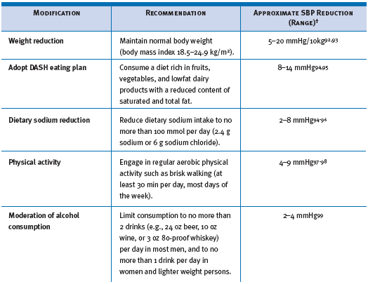
Lifestyle modifications
www.nhlbi.nih.gov

Slide 15
The DASH Diet
The DASH Diet includes:
7-8 servings of grains and grain products
4-5 servings of vegetables
4-5 servings of fruits
2-3 servings of low fat dairy products
2 or less servings of meat, poultry and fish
2-3 servings of fats and oils
Nuts, seeds and dry beans 4-5 times /week
Limited ‘sweets’ low in fat.

Slide 16
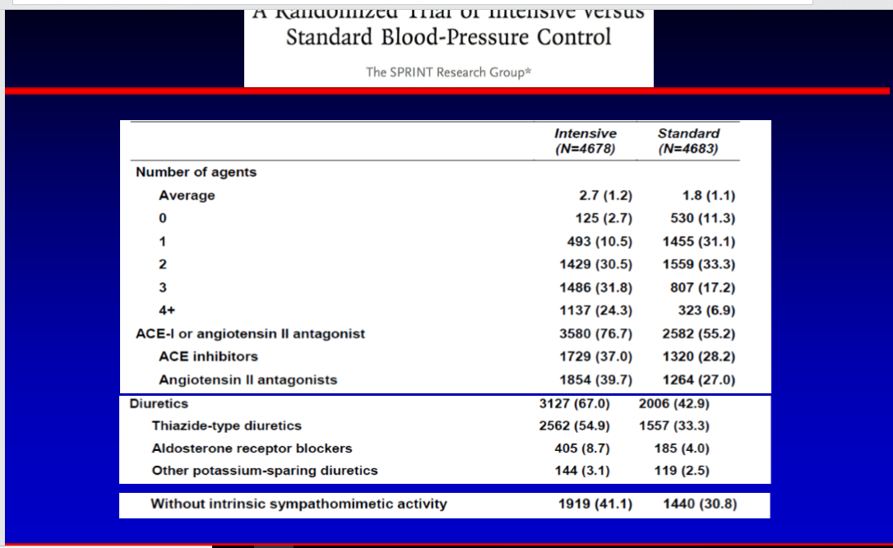

Slide 17
Hypertensive Crises
Hypertensive Urgencies: No progressive target-organ dysfunction. (Accelerated Hypertension)
Hypertensive Emergencies: Progressive end-organ dysfunction. (Malignant Hypertension)

Slide 18
Hypertensive Emergencies
Severely elevated BP (>180/120mmHg).
With progressive target organ dysfunction.
Require emergent lowering of BP.
Examples: Severely elevated BP with:
Hypertensive encephalopathy
Acute left ventricular failure with pulmonary edema
Acute MI or unstable angina pectoris
Dissecting aortic aneurysm

Slide 19
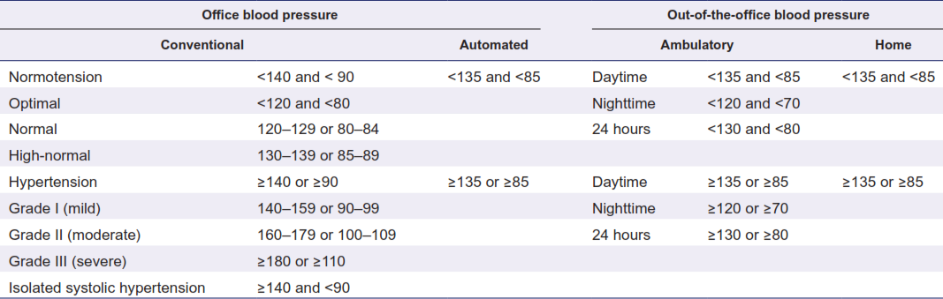
Systolic and Diastolic Blood Pressure Thresholds for Blood Pressure
American Journal of Hypertension 30(5) May 2017

Slide 20
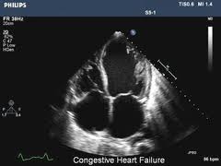
Young patient with HTN
IF not secondary causes
Normal echo
If HR >60, 1st choice BB
If level is not desirable add CCB
If target is not achievable add CTL. HTCZ

Slide 21
Patient with DM, HTN
Treatment for HTN
1),First choice combo of BB and ACEI or ARB
2), HCTZ or CTL
3), CCB
4), Alpha blockers
5), Aldosterone RB
Normal echo

Slide 22
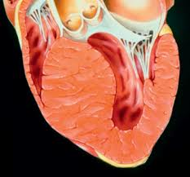
Patient with ASH with HTN with normal EF
Treatment
1, BB
2, CCB,
3, ACEI or ARB
4, ALRB
ASH

Slide 23
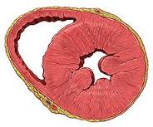
Patient with LVH and HTN
Treatment
1, BB
2, CCB if not DM, if DM ACEI or ARB
ALRB
LVH

Slide 24
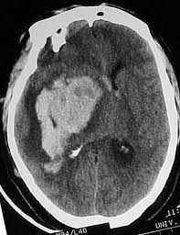
HTN with CVA
Treatment in NRF
1, ACEI or ARB
2, CCB
3, CTL
4, BB
5, ALRB
CVA

Slide 25
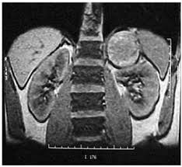
HTN with Phechromacytoma
Treatment
1, Alpha blockers
2, BBs
3, ALRB
Phechromacytoma

Slide 26
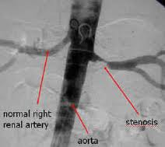
HTN in RAS
Treatment
1, CCb
2, Alpha blockers
3, LD
4, BBs
5, strictly no CTL, HCTZ, ACEI, ARB
Renal artery stenosis

Slide 27
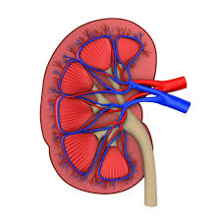
HTN in CKD
Treatment
1, CCb
2, BBs
3, Alpha Blockers
4, LDs
5, Nitroglycerine
CKD

Slide 28
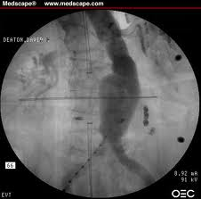
HTN in Aortic aneurysm
Treatment
1, BBs
2, non vasodilating CCB
Aortic aneurysm

Slide 29
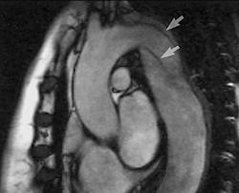
HTN in Aortic dissection
Treatment
1, IV BBs
2, Urgent surgery
Aortic dissection

Slide 30
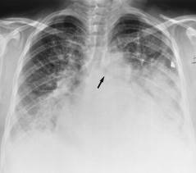
HTN with Pulmonary edema
Treatment for PE
1, Nitroglycerin
2, LDs

Slide 31
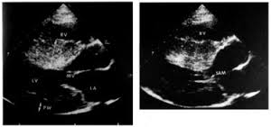
HOCM with HTN in normal EF
Treatment
1, Verapamil
2, BB
3, diltiazem
4, strictly no vasodilators
HOCM echo

Slide 32
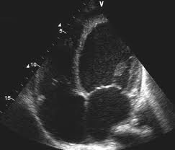
Patient with Dilated cardiomyopathy and CCF
Treatment
1, ACEI or ARB
2, Carvedelol
3, ALRB, LD
4, mono or dinitrates or nitroglycerin
Reduced EF30-40%

Slide 33
Device Based Treatment for HTN
1, Endovascular Implant
2, Denervation of carotid bulb, body, median nerve, and renal nerve denervation.
3, Alcohol RND.
4, AV Fistula
5, Pace Maker mediated

Slide 34
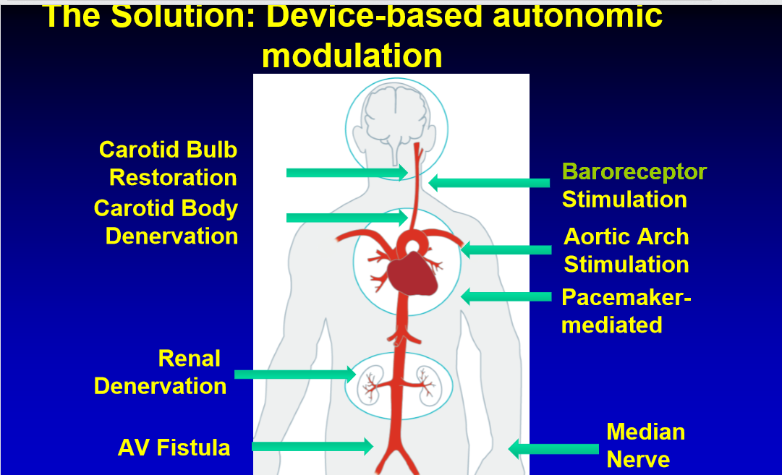

Slide 35
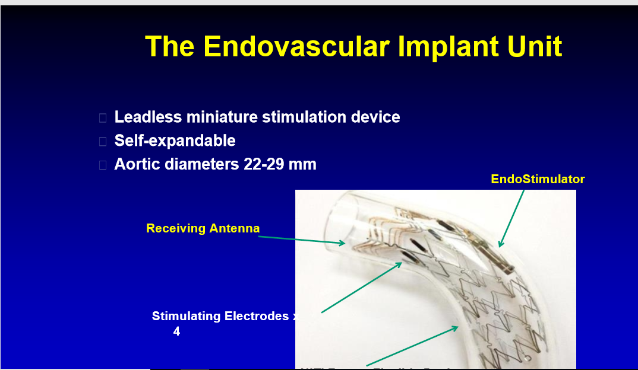
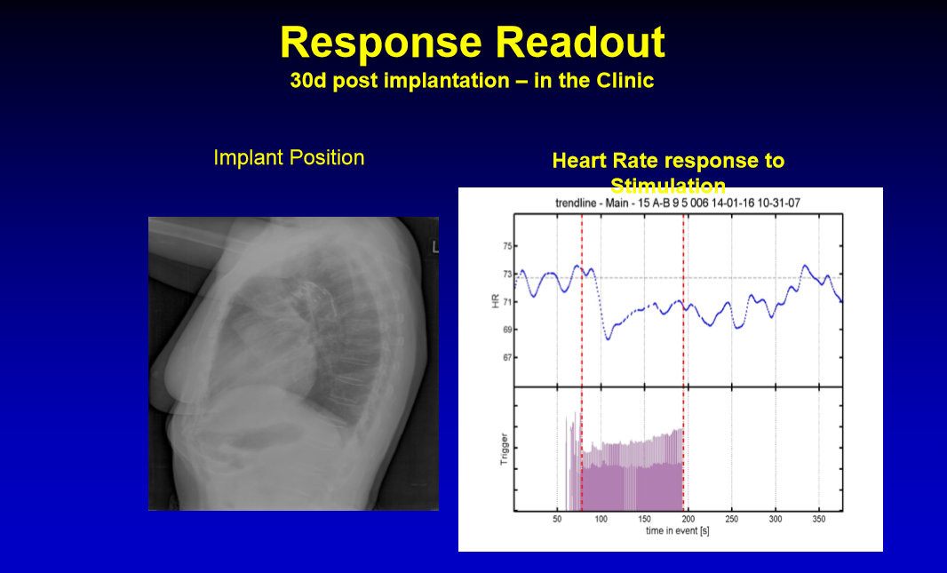
Aortic Implant

Slide 36
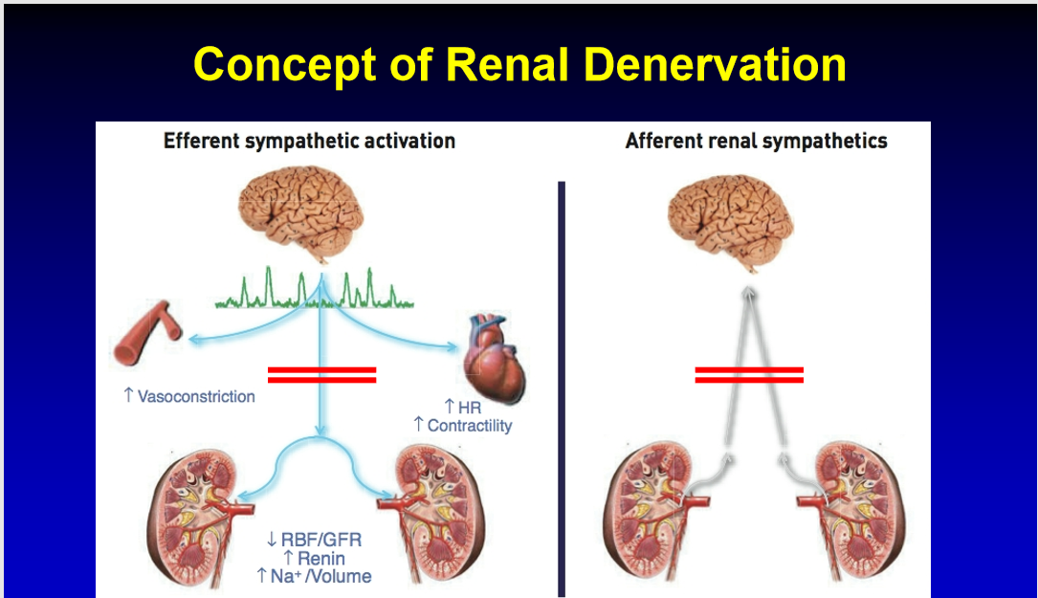

Slide 37
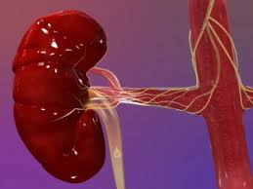
Renal Nerve Denervation

Slide 38
Thank you for your attention
Visit Ipcard TV in youTube channel- a channel for doctors and patients information
www.ipcard.org

